Slide 1
Autonomic activities during
various types of video game tasks
Yuichiro Nagano
Department of Human Studies, Bunkyo Gakuin University, Japan
Notes:
Let me start presentation titled… Autonomic activities during various types of videogame tasks.
ここに紹介を受けて、このような場で発表できるのは光栄だ的な文章が必要？？？

Slide 2
Introduction
In Japan, there are many companies which develop and supply video games. However, the number of studies that examine their psychophysiological effects is still low.
To investigate the effects of video games on autonomic activities and subjective affect, we conducted four experiments using various types of video games, namely puzzle action, versus beat 'em up, horror, and car racing.

Slide 3
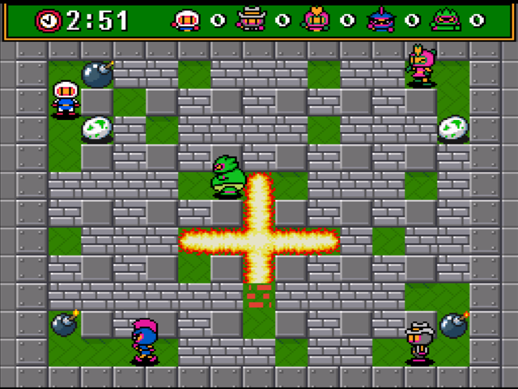
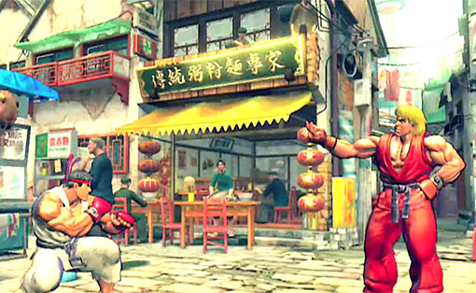
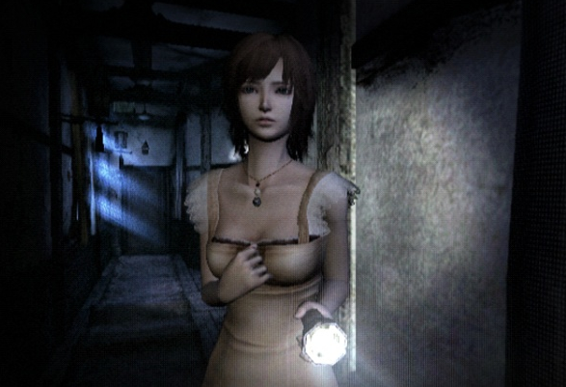
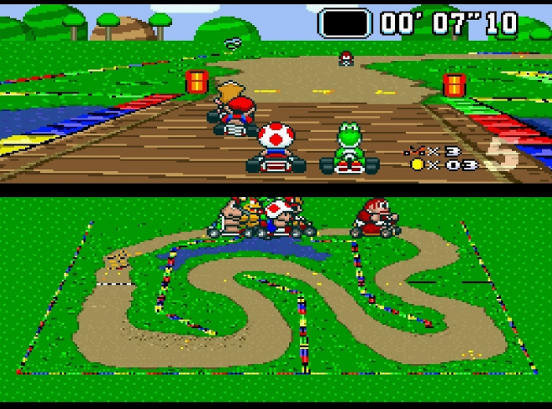
Experiment1
Experiment2
Puzzle action
Versus beat 'em up
Experiment3
Experiment4
Horror
Car racing

Slide 4
Competitive puzzle action game
SuperBomberman3 （HUDSON SOFT）
Players control their own character and drop bombs on the map and defeat opponents by the flame. Game title for Super Nintendo Entertainment System. Despite its simple look, versus play is extremely exciting. So popular in Japan, most of participant has already known the game operation.
Notes:
In the first experiment, we used SuperBomberman3 as a competitive puzzle action game. In this game, players control their own character, drop bombs on the map, and defeat opponents with fire. Despite its simple look, its play is extremely exciting.

Slide 5
Purpose
To investigate the effect of puzzle action games on autonomic activities and subjective affect, during various social situation.
Method
Participants：41 students (25 men and 16 women)
(mean age=21.3 ±2.9 years).
Task：SuperBomberman3 for SNES （HUDSON SOFT）.
Experimental Design：Within subject design.
Experimental conditions and time schedule：
Rest
1min
Task
2min
Recovery
1min
:Affect Scale
Alone
: Game experience
vsComputer
Rest
1min
Task
2min
Recovery
1min
vsHuman
Rest
1min
Task
2min
Recovery
1min
Figure 1-1. Experimental schedule.
Notes:
The purpose of this experiment was to investigate the effect of puzzle action games on autonomic activities and subjective affect during various social situations.
We employed 41 students, who participated in all of three experimental conditions, which were playing alone, vsComputer, and vsHuman. In the alone condition, participants destroyed the wall and gathered game items. During vsComputer and vsHuman conditions, they fought with their opponents. Each condition consisted of one minute of rest, two minutes of task, and one minute of recovery. The executing order of the three conditions was counterbalanced. We measured the subjective affect prior to the first condition and after three conditions. Game experience was also measured after each condition. As for the subjective affect, we asked participants to recall and answer the affect in the task period.

Slide 6
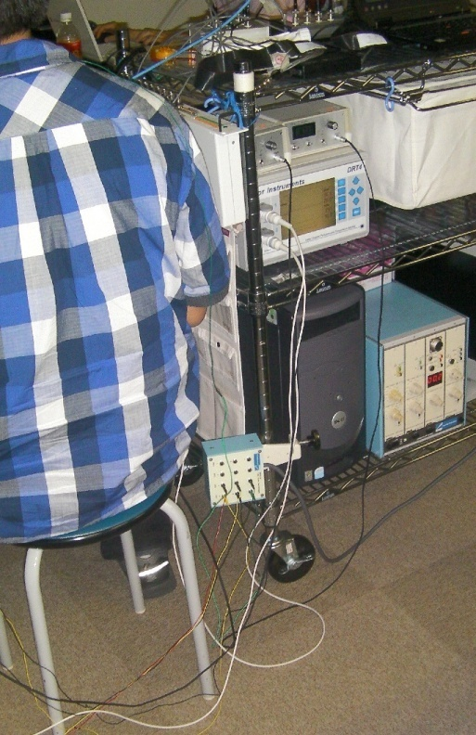
Psychological measures：
1. General Affect Scale, consisted of 24 adjective-items that were arranged in three dimensions, Positive affect (PA), Negative affect (NA), and Calm affect (CA) (Ogawa, Monchi, Kikuya & Suzuki,2000).
2. Original Game experience questionnaire, consisted of following six items, ”had fun,” ”felt heart pounding,” “was caught up,” “concentrated,” “felt the excitement,” “was fired up”.
Pysiological measures：
1. Heart rate (HR), recorded with a general purpose bio-information amplifier AB-621G (Nihonkoden, Japan).
2. Skin conductance (SC), recorded from fourth and fifth finger of the non-dominant hand with a skin conductance amplifier DA-3 (Vega Systems, Japan).
3. Finger blood flow (FBF), recorded from fourth finger of the non-dominant hand with a laser doppler flowmetry FLO-C1 (Omegawave, Japan).
Notes:
In this experiment, we used two psychological measures. The first was the general affect scale, consisting of 24 adjective items that were arranged in three dimensions: positive affect (PA), negative affect (NA), and calm affect (CA). The second was the original game experience questionnaire, consisting of the following six items: ”had fun,” ”felt heart pounding,” “was caught up,” “concentrated,” “felt the excitement,” “was fired up.”
We employed three physiological measures as indices of autonomic activity, namely heart rate (HR), skin conductance (SC), and finger blood flow (FBF). Skin conductance and finger blood flow were recorded from the fourth and fifth finger of the non-dominant hand.

Slide 7
Result（Game experience）
・Significant main effect of condition (F(2,80)=63.2, p<.001).
・Significant differences were found between all of the conditions using Tukey’s HSD test (p<.01).
**
**
**
Figure 1-2. Mean game experience score for each condition.
Notes:
First, I will show the result of the game experience. As shown in the figure, the highest score was in the vsHuman condition and the lowest score was in the alone condition. We performed a one-way ANOVA and found significant effects of condition. Multiple comparisons test also revealed significant differences between all three conditions.

Slide 8
Result（General Affect Scale ）
・Significant condition effects were found in all dimensions of the affect scale (PA:F(2,80) = 35.93, p<.001; NA:F(2,80)=12.09, p<.001; CA:F(2,80)=31.65, p<.001).
・Differences of PA change score between all conditions were significant
(p<.001).
・Differences between vsComputer and vsHuman were not significant
in the NA and CA score changes.
PA
NA
CA
Figure 1-3. Mean change score of general affect scale for each condition.
Notes:
Next is the result of general affect scale. In this figure, mean change scores from the base are shown. We conducted a one-way ANOVA for every dimension and found significant condition effects in all of them. As for NA and CA, there were no differences between the two competitive conditions. Only in PA, differences between all conditions were significant. Only the vsHuman condition showed a PA increase.

Slide 9
Result (Heart Rate)
・HR increased in task period, mainly in two competitive conditions.
・Significant condition effect (F(2,80)=5.58, p<.01).
・Result of multiple comparison showed, alone < vsComputer = vsHuman
(Tukey’s HSD test, p<.05).
(bpm)
Rest
Task
Recovery
N=41
1
2
3
4
(min)
Figure 1-4. Mean HR during rest, task, and recovery period for the three conditions.
Notes:
This figure shows the HR variation in each condition. HR increased in the task period and decreased in recovery. Changes in the rest period of the two competitive conditions were at the same level. We calculated the change value from rest period and performed a one-way ANOVA using them. In the calculation, we used an average value of last 30 seconds of rest period as a base. As a result, we found significant condition effect. Multiple comparison tests showed no difference between the two competitive conditions.

Slide 10
Result (Skin Conductance)
・SC increased in task period, especially in vsHuman conditions.
・Significant condition effect (F(2,80)=8.06, p<.001).
・Result of multiple comparison showed, alone = vsComputer < vsHuman
(Tukey’s HSD test, p<.05).
(μS)
Rest
Task
Recovery
N=41
1
2
3
4
(min)
Figure 1-5. Mean SC during rest, task, and recovery period for the three conditions.
Notes:
As for skin conductance, variations in the task period were different in each condition. As a result of statistical analysis, we found a significant condition effect. Unlike in the case of HR, differences in vsComputer and vsHuman were significant, but there was no difference between the alone and vsComputer condition.

Slide 11
Result (Finger Blood Flow)
・FBF decreased in task period in all conditions.
・No significant effect was found (F(2,80)=1.59, ns).
(ml/100g/min)
Rest
Task
Recovery
N=41
1
2
3
4
(min)
Figure 1-6. Mean FBF during rest, task, and recovery period for the three conditions.
Notes:
There was a prominent decrease in finger blood flow in the task period, which recovered gradually after finishing the gameplay. The vsHuman condition seemed to maintain the lowest value throughout the periods.
However, we found no significant difference between conditions.

Slide 12
Result (Correlation of each measure)
Table 1-1. Correlation between each psychological and physiological parameter.
Alone
vsComputer
vsHuman
Notes:
This table shows the correlation coefficients between each measure classified by condition. All of these correlation coefficients were calculated using the change score. In the alone condition, finger blood flow showed a significant correlation with all three dimensions of subjective affect. However, only a positive correlation between finger blood flow and calmness was carried through the conditions. Compared with the alone condition, the vsHuman condition indicated lower coefficients overall.

Slide 13
Discussion
・Generally increased sympathetic activity enhances gameplay experience scores.
・An increase of negative affect and decrease in calmness also contributes to the fun of gameplay.
・Despite the game experience score difference, contrast of physiological measures between conditions were ambiguous.
-> The possibility of task specific response in HR change.
-> The possibility of individual difference of reactivity.
Notes:
In this experiment, we observed accelerated HR, increased SC, and decreased FBF. These are reflections of heightened sympathetic activity. In the subjective affect scale, we found an increase in negative affect and a decrease in calmness. It suggests that change in affect to negative direction can contribute to an improved game experience. Despite the subjective game experience difference, condition differences in each physiological measure were ambiguous. So-called vigilance tasks that need attention based on visual stimuli are likely to decrease HR through parasympathetic activity. Such task specific responses or individual differences in cardiovascular/electrodermal reactivity might have influenced the responses.

Slide 14
Versus beat 'em up game
Street Fighter IV (CAPCOM)
Versus beat 'em up game for PS3. Game characters are so detailed, even in their expression or gesture, players likely to emphathize with them. Street Fighter series are fairly popular in Japan gamers, and easy to find experienced participant.
Notes:
In the second experiment, we used Street Fighter IV as a versus beat 'em up game. In this game, characters are so detailed—even in their expressions or gestures—that players are likely to sympathize with them.

Slide 15
Purpose
To investigate the effect of versus beat 'em up games on autonomic activities and subjective affect, during various social situation.
Method
Participants：40 students (35 men and 5 women)
(mean age=21.0 ±1.83 years).
Task：Street Fighter IV for Playstation3 (CAPCOM).
Experimental Design：Within subject design.
Experimental conditions and time schedule：
Rest
1min
Task
2min
Recovery
1min
:Subjective affect
Alone
:Game experience
vsComputer
Rest
1min
Task
2min
Recovery
1min
vsHuman
Rest
1min
Task
2min
Recovery
1min
Figure 2-1. Experimental schedule.
Notes:
As shown in this picture, the experimental design and condition settings were almost the same as those of the previous experiment. During the task of individuals fighting alone, the participant attacked the opponent, which did not move. During vsComputer and vsHuman condition, the participants fought with a moving opponent.
The methods of psychological and physiological assessment were exactly the same as in the previous experiment.

Slide 16
Result（Game experience）
・Significant main effect of condition (F(2,78)=76.15, p<.001).
・Significant differences were found between all of the conditions using Tukey’s HSD test (p<.05).
**
**
**
Figure 2-2. Game experience score for each condition.
Notes:
I will now show the results of the game experience scores. As shown in the figure, the order of the game experience score was as follows: vs. Human was first, vs. Computer was second, and alone was third. This figure was almost same as that for the previous experiment in both shape and actual value.
We performed a one-way ANOVA and found significant condition effect. Multiple comparisons test also revealed significant differences between all three conditions.

Slide 17
Result（General Affect Scale）
・Significant condition effects were found in all dimensions of the affect scale
(PA:F(2,78) = 19.87 ,p<.001; NA:F(2,78)=29.65,p<.001; CA:F(2,78)=32.42,p<.001).
・Differences of PA change score between all conditions were significant
(p<.001).
・Differences between vsComputer and vsHuman were not significant
in the NA and CA score changes.
PA
NA
CA
Figure 2-3. Mean change score of general affect scale for each condition.
Notes:
This slide is the result of the general affect scale. As in the previous experiment, we found significant condition effects in all three dimensions. The other statistical results were also quite similar to the previous experiment.

Slide 18
Result (Heart Rate)
・Performed one way ANOVA on the change value of HR.
・Significant condition effect (F (2,78)=26.45, p <.001) .
・Significant differences between all conditions (Bonferroni, ps<.05).
(bpm)
Rest
Task
Recovery
N=41
1
2
3
4
(min)
Figure 2-4. Mean HR during rest, task, and recovery period for the three conditions.
Notes:
This figure shows the heart rate (HR) variation. The manner of HR fluctuation resembles that of puzzle action games, but the scores changes from the base were clearly larger than for puzzle action games and the differences between the three conditions were more obvious.
As a result of the ANOVA, we found significant condition effects. Multiple comparison tests showed significant differences between all conditions.

Slide 19
Result (Skin Conductance)
・Significant effect of condition (F (2,78)=13.12, p <.001) .
・The differences between alone and two competitive conditions were significant (Bonferroni, p<.05).
・No significant difference between the two competitive conditions.
(μS)
Rest
Task
Recovery
N=41
1
2
3
4
(min)
Figure 2-5. Mean SC during rest, task, and recovery period for the three conditions.
Notes:
Skin conductance also showed a larger change than puzzle action game. We found not only a larger reactivity, but also a sharp initial rising. As shown in the picture, the differences between the two competitive conditions were not large.
We performed a statistical analysis in the same manner and found a significant condition effect, but there was no difference between two competitive conditions.

Slide 20
Result (Finger Blood Flow)
・Significant effect of condition (F (2,64)=7.10, p <.001) .
・Only the difference between the alone and the vsHuman conditions was significant (Bonferroni, p<.05).
(ml/100g/min)
Rest
Task
Recovery
N=41
1
2
3
4
(min)
Figure 2-6. Mean FBF during rest, task, and recovery period for the three conditions.
Notes:
The finger blood flow decreased rapidly in the task period, and only the vsHuman condition seemed to sustain the vasoconstriction to the end of the task period. In the other two conditions, it seemed that vasodilation gradually occurred over time.
As a result of the ANOVA, we found a significant condition effect, and multiple comparison test showed significant difference only in the alone and vsHuman condition.

Slide 21
Discussion
・The results of psychological measures were entirely the same with puzzle action game.
-> Differences in physiological responses reflect the game task specificity.
・The versus beat 'em up game also enhanced sympathetic activity, but the physiological reactivity was much greater than that of the puzzle game.
-> The difference of game system like a sense of distance.
-> The difference of the method of fighting.
・The difference for the condition of HR reactivity was clearer than for the puzzle game.
-> Lower parasympathetic influence in versus beat 'em up game.
Notes:
For the versus beat 'em up game, we found a result similar to that of the puzzle game. Especially in the results of psychological measures, we found very little difference between the two games. Therefore, physiological response seemed to account for the specificity of versus beat 'em up games.
In general, it appears that versus beat 'em up games induced larger and more acute physiological responses. However, there are clear differences between individual game systems
In the case of Bomberman, players had to break the wall and make a route to their opponent at the beginning. However, in the case of StreetFighter IV, players make contact with their opponents in minimal time. Another distinction is that in the former game, players indirectly attack opponents with fire, but in the latter, they employ more direct attacks such as punches or kicks.
Furthermore, in most of the puzzle games, players were forced to observe the screen carefully to estimate an appropriate strategy. There are possibilities that such differences in game systems or attack methods explain the physiological differences observed in players when using the two games.

Slide 22
Horror game
Fatal Frame IV: Mask Of The Lunar Eclipse (Techmo)
The fourth installment of very famous survival horror video game series in Japan. In this game, the player wanders around an abandoned old hospital to exorcise evil spirits using a camera that has the ability to seal them onto film.
Notes:
In the third experiment, we used Fatal Frame IV. This game is the fourth installment of very famous survival horror video game series in Japan. In this game, the player wanders around an abandoned old hospital to exorcise evil spirits using a camera that has the ability to seal them onto film. This game is software for the Nintendo Wii and adopts intuitive manipulation by utilizing a motion controller.

Slide 23
Purpose
To investigate the effect of horror games on autonomic activities and subjective affect.
Method
Participants：25 students (21 men and 4 women)
(mean age=20.96 ±1.70 years).
Task：Fatal Frame IV: Mask Of The Lunar Eclipse (Tecmo).
Time schedule：
Rest
5min
Task(consisted of 8 game event)
20min 11s on average
Recovery
3min
:Affect Scale
:Game experience
Figure 3-1. Time schedule of experiment.
Notes:
The purpose of this experiment was to investigate the effect of horror. We employed 25 students in this experiment. Unlike the previous two, this experiment did not contain an interpersonal condition.
The experiment consisted of five minutes of rest, an arbitrary task length, and three minutes of recovery. The average length of the task was approximately 20 minutes.
We measured the subjective affect prior to the rest period and after the recovery. Game experience was also measured after the recovery. The method of physiological assessment was exactly the same as in the previous two experiments.

Slide 24
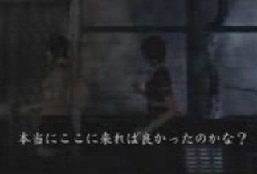
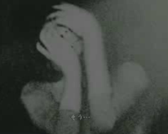
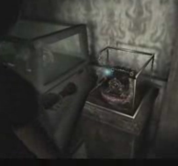
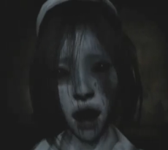
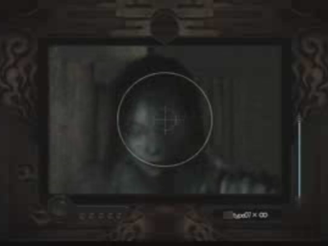
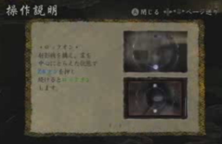
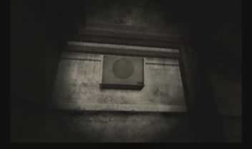


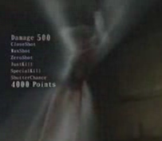

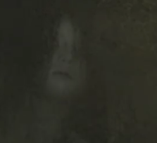

Game Events for Analysis
Rest
Introduction Movie
Finding
old Camera
Female nurse Ghost
Fear inducing Music
Old camera
Tutorial
Inpatient Ghost 1
Fight with Ghost
Inpatient Ghost 2
Ending Movie
Recovery
Figure 3-2. Game events during task period.
Notes:
We picked nine events as shown in this figure. Throughout first five events, players mainly wandered around the hospital and sought keys to open the room where the camera was stored. In these steps, the ghost just surprised the player and did not attack him. After finding the camera, the player was attacked by the ghost for the first time and they fought.

Slide 25
Result（Psychological measures）
・The game experience score of horror game was comparable to that of prior two action games in vsComputer condition.
・The score of Subjective affect scale significantly changed from rest to task in all three dimensions (ps<.01).
・NA score change was clearly larger than that of prior two experiments.
vsComputer
condition
Figure 3-3. Game experience score of three types of game.
Figure 3-4. General affect score change in horror game.
Notes:
These figures show the results of the psychological scales. Despite the negative direction of affect as a whole, the game experience score was comparable to that of the previous two games. The scores of two action games have been provided to show the scores of their vsComputer condition.
As shown in the right figure, positive affect was clearly decreased and negative affect increased twofold compared to the previous action game. We conducted paired t-tests with three dimensions of subjective affect scale and found significant changes in all of them.

Slide 26
Result (Heart Rate)
・Prominent increase of HR only around the fighting event.
・Generally lower HR reactivity during wandering.
(bpm)
**
**
**
N＝25
Rest
Nurse
Patient
Camera
Fight
Recovery
Figure 3-5. Variation of heart rate during experiment.
Notes:
This figure shows the heart rate variation while playing the horror game. The shape of HR curve was different from previous experiments. We could not find a definite increase of HR from the beginning of the game until reaching the camera room. The result of a one-way ANOVA and a multiple comparison indicated a significant increase in HR––this mainly occurred around the fighting event.

Slide 27
Result (Skin Conductance)
・Increased from the rest and sustained the value through the wandering.
・Increased more around the fighting event.
(μS)
**
*
**
N＝25
**
Rest
Nurse
Patient
Camera
Fight
Recovery
Figure 3-6. Variation of skin conductance during experiment.
Notes:
This figure shows the skin conductance variation. The characteristics of this curve were two hump shapes. Unlike the HR, SC increased in the anterior half of task period and increased once again when fighting with the ghost. The result of the statistical analysis supported the validity of the two-hump shape as a whole.

Slide 28
Result (Finger Blood Flow)
・Decreased from the rest and sustained the value through the wandering.
・Showed roughly inverted curve of skin conductance variation.
(ml/100g/min)
**
**
**
N＝25
Rest
Nurse
Patient
Camera
Fight
Recovery
Figure 3-7. Variation of finger blood flow during experiment.
Notes:
The finger blood flow was found to be just like the vertically inverted curve found in SC. Finger blood flow was decreased from the beginning of the task period and stayed at a lower state until the camera room, and it decreased again during the fighting. The result of the statistical analysis shown in this picture indicates this two-stage decrease of FBF.

Slide 29
Discussion
・Entirely negative direction of emotional change can produce satisfiable game experience.
-> Need to understand subjective affect and game experience separately.
・Definitive distinction in variation of each physiological measure.
-> The lower HR must be a specificity of horror game.
-> The possibility of enhanced parasympathetic activity during wandering.
Notes:
For the survival horror game, the manner of the reaction was obviously different in both of psychological and physiological aspects compared to the two previous action games. Subjective affect became a negative direction in all dimensions. However, the game experience score sustained a fairly high state. Such apparent inconsistent relationships might be an anomalous phenomenon of entertainment study. It means that the researcher should distinguish total game experience from acute emotional change during gameplay. Static HR during the anterior half of the task period looks quite strange when compared to SC and FBF. Seeking game items like the key or camera by using their own perceptive function might have influenced the parasympathetic nerve in their heart.

Slide 30

Car racing game
Super Mario Kart for SNES (Nintendo)
Super Mario Kart is the first game of Nintendo’s extremely famous series of go-kart-style racing game. Players compete in go-kart races, controlling own character. One of the features of the series is the use of various power-up items obtained during driving on the course. This series is also an enduring bestseller in Japan, and finding experienced participant was so easy.
Notes:
We used Super Mario Kart as THE fourth game. This is the first game in Nintendo’s extremely famous series of go-kart style racing games. Players compete in go-kart races, each controlling their own character. The feature of this game is the use of various power-up items obtained while driving on the course.

Slide 31
Purpose
1. To investigate the effect of car racing game on autonomic activities and subjective affect, during various social situations.
2. To investigate the habituation preventing effect of interpersonal stimulus.
Method
Participants：61 students (43 men and 18 women)
(mean age=20.54 ±2.97 years).
Task：Super Mario Kart for SNES (Nintendo)
Experimental Design：Mixed subject design.
Experimental conditions and time schedule：
vsComputer
group
Rest
1min
Task
2min
Recovery
1min
Rest
1min
Task
2min
Recovery
1min
Rest
1min
Task
2min
Recovery
1min
:Subjective affect
vsHuman
group
Rest
1min
Task
2min
Recovery
1min
:Game experience
+ boredom
Rest
1min
Task
2min
Recovery
1min
Rest
1min
Task
2min
Recovery
1min
Figure 4-1. Experimental design and schedule.
Notes:
In this experiment, we had two purposes. The first was to investigate the effect of car racing games in a manner similar to the previous two action games. The second was to investigate the effect of the interpersonal communication on habituation.
To investigate these effects, we randomly assigned 61 participants to two groups. The participants of each group conducted experimental sessions a total of three times. One group competed with the computer and the other did same tasks with a human.
The methods of psychological and physiological assessment were almost the same as in the previous experiment except three adjectives were added as indices of subjective boredom: “tired,” “bored,” and “unamused.”

Slide 32
Result（Game experience / Boredom）
・Significant main effect of group and time with game experience score
(group :F(1,55)=9.89, p<.01; time :F(2,110)=7.46, p<.001),
and multiple comparison test indicated, first > second = third.
・Significant main effect of group and time with boredom score
(group :F(1,55)=19.65, p<.001; time :F(2,110)=4.83, p<.01),
and multiple comparison test indicated, third > second = first.
Figure 4-2. Mean game experience score of each group across times.
Figure 4-3. Mean boredom score of each group across times.
Notes:
These figures are the result of game experience and subjective boredom. In the left figure, we can see a gradual decrease of game experience score in both groups. The statistical analysis shows a significant main effect of group and time. No significant interaction of group and time was found.
The boredom score seems to indicate a progressive increase only in the vsComputer group. However, we could not find a significant interaction in this scale either. According to these results, we can say that the interpersonal situations effect enhanced the base level of subjective fun but was not enough to prevent boredom.

Slide 33
Result（General Affect Scale）
・No significant main effect or interaction in PA.
・Significant main effect of time in NA (F(2,110)=25.23, p<.001),
and multiple comparison test indicate first > second = third.
・Significant main effect of time in CA (F(2,110)=5.76, p<.01),
only difference between first and third was significant.
PA
NA
CA
Figure 4-4. Mean change score of general affect scale for each condition across times.
Notes:
The most apparent characteristics of subjective affect in the car racing game were relatively low change scores in NA and CA. Roughly speaking, they showed a 50—60 percent change compared to previous games.
Also in the subjective affect scale, we could not find an interaction of group and time. In fact, we barely found any significant time effects in NA and CA. Overall, the habituation preventing effect by human on this scale was fairly obscure.

Slide 34
Result (Heart Rate)
・Only the main effect of time was significant (F(2,112)=18.02, p<.001),
multiple comparison indicated, first > second = third.
・No significant group effect and interaction.
(bpm)
vsComputer
(bpm)
vsHuman
N=30
N=31
1st
2nd
3rd
1st
2nd
3rd
Rest
Task
Recovery
Rest
Task
Recovery
Figure 4-5. Mean HR variation of each group for the across times.
Notes:
As for the HR variations, it seemed that humans prevented the habituation and kept HR at a higher level through the task.
We calculated the change value from the rest period and used them to perform a two-way mixed design ANOVA. As a result, we found significant time effect but no group effect or interaction between them.

Slide 35
Result (Skin Conductance)
・Significant main effect of time (F(2,112)=6.12, p<.01),
multiple comparison indicated, first > second = third.
・Significant interaction of group and time was found (F(2,112)=6.16, p<.01).
(μS)
vsComputer
(μS)
vsHuman
N=30
N=31
1st
2nd
3rd
1st
2nd
3rd
Rest
Task
Recovery
Rest
Task
Recovery
Figure 4-6. Mean SC variation of each group for the across times.
Notes:
Unlike previous figures, this figure seems to show that humans prevented the decrease of SC and kept the heightened reactivity through sessions. We conducted a statistical analysis in the same manner and found significant time effect and interaction of group and time. This suggests that competition with a human prevents the habituation of sympathetic activity and contributes to the lifetime of that game title.

Slide 36
Result (Finger Blood Flow)
・Interaction of group and time was marginally significant
(F(2,112)=2.06, p<.10).
・No significant main effects.
(ml/100g/m)
vsComputer
(ml/100g/m)
vsHuman
N=30
N=31
1st
2nd
3rd
1st
2nd
3rd
Rest
Task
Recovery
Rest
Task
Recovery
Figure 4-7. Mean FBF variation of each group for the across times.
Notes:
With regard to the finger blood flow change, interaction of group and time was marginally significant. It also supported the possibility of habituation preventing effect of human declared in the previous slide.

Slide 37
Discussion
・The habituation process reflected on the subjective measures were generally ambiguous.
-> The possibility of need for more repeating process.
-> The possibility of low sensitivity in subjective
habituation of human.
・Relatively clear habituation process and tendency of interpersonal communication to prevent habituation.
-> The possibility of autonomic activity reflecting the state of habituation more sensitively.
Notes:
In this experiment, we investigated the habituation process both in psychological and physiological aspects. The habituation process shown in the psychological aspect seemed to be ambiguous. Too few repeating processes may have been adopted in this experiment to properly investigate valid habituation processes in game playing. There is another possibility that the sensitivity in subjective habituation of humans is essentially low. Despite the subjective scale, it seems that the habituation process and tendency of humans to prevent it were relatively clear in physiological aspects. If these indices are able to reflect the habituation state more sensitively, we might be able to utilize them to develop video games that have a longer lifetime.

Slide 38
General discussion
・Game task specificities were found in both subjective and physiological measurement.
・Observed specific responses were matched with game contents.
->There is great potential to utilize video games as methods for the elicitation of emotions.
・Reactivities of psychological and physiological measures were related to game experience in gross.
・However relationships between these responses and game experience were superficially inconsistent in some instances.
->Understanding game category specificity in physiological measurements will improve their availability for evaluating many aspects of video games.
Notes:
Through four experiments, we found game task specificities in both subjective and physiological measurements. We observed specific responses seemed to match the game contents. For example, focusing on finding something in the game induced increased electrodermal activity but did not change heart rate, but using kick or punches in the game increased heart rate. Therefore, I think there is great potential to utilize video games as methods of emotion elicitation in psychological experiments.
Reactivities of psychological and physiological measurements were related to game experience overall. However, in some instances, relationships between these responses and game experience were superficially inconsistent. Understanding game category specificity in physiological measurements will improve their availability for evaluating many aspects of video games.

Slide 39
Thank you all for listening!
Notes:
In closing, I would like to thank you all for listening so attentively.

