Slide 1
The impact of active coping aspects on autonomic responses during video game playing
Yuichiro Nagano, Rina Taira, Kohei Fuseda
Department of Human Studies, Bunkyo Gakuin University, Japan
Nobuyuki Kawai, Shota Watanabe
Department of Cognitive Science, Nagoya University
Kazuo Okanoya
Department of Cognitive and Behavioral Sciences, The University of Tokyo
Notes:
Good morning everyone, my name is Yuichiro Nagano from Bunkyogakuin university.
It is my honor and great pleasure to have opportunity to introduce our latest study,
The impact of active coping aspects on autonomic responses during video game playing.
Now, let me start presentation.

Slide 2
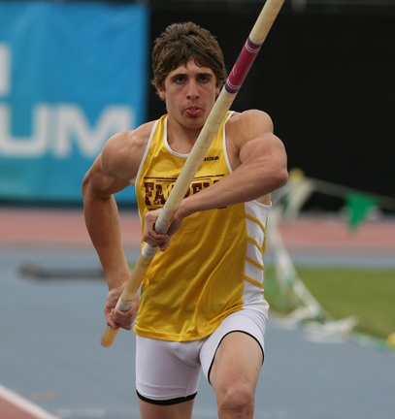

Introduction
When control is given to a person in a stressful situation, an increased cardiac response often occurs. This is widely known as active coping (Obrist, 1981).
Notes:
When control is given to a person in a stressful situation, an increased cardiac response often occurs. This is widely known as active coping (Obrist, 1981). A similar response occurs in a situation that induces a positive affect. However, relative to a stressful situation, the(ジ) influence on the body under non-stressful situations is not clear.

Slide 3



・Sophisticated visual audio stimulus
・Inducing various types of emotion
・Highly immersive state
Notes:
Video games are a new type of entertainment that provide opportunities to control the situation around a player. As electronic devices become more sophisticated, video and audio quality is also rapidly improving. As a result, many video games can now induce a highly immersive state. They thus afford a promising entry for tasks that can provoke various types of emotions in the laboratory setting.

Slide 4
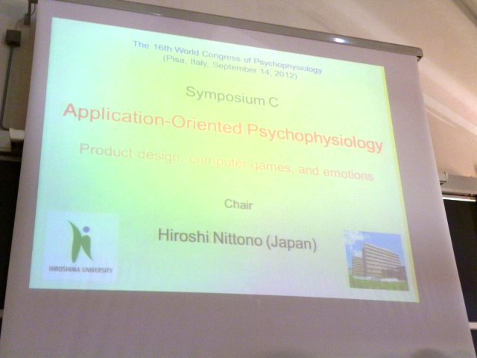


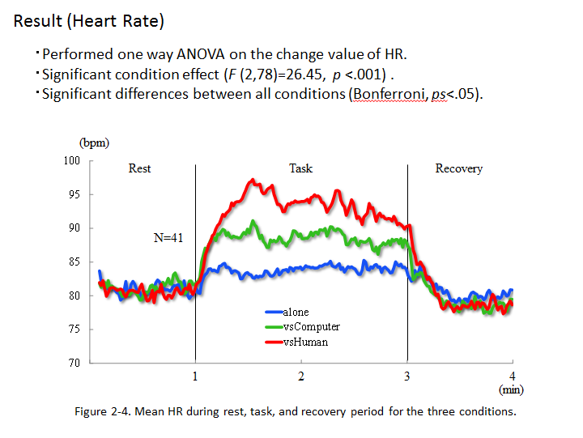
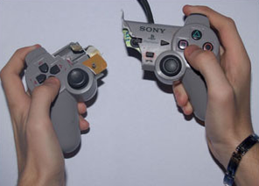
Notes:
At the previous IOP conference in Pisa, I introduced my investigation of autonomic activities during various types of video game tasks in the symposium – Application-Oriented Psychophysiology – organized by Dr. Nittono. While we often observe impressive autonomic changes during video game tasks, we also frequently asked the question, “Is this just a response caused by the body movement?”
Actually, while obserbing the enthusiastic player playing with video games, I feel some anxiety, “How can we avoid such criticism…?”

Slide 5

Active Coping
Body movement
Autonomic
response
Body
movement
Active
Coping
Active Coping
Body
movement
or
Notes:
Unlike an ordinary psychological task, game playing intrinsically includes body movement, and we cannot distinguish the(ジ) effect of active coping from the(ジ) influence of body movement when evaluating emotional arousal using autonomic responses. If we try to evaluate the degree of enjoyment of a video game by measuring autonomic activity, we at least should know the ratio of active coping to body movement in terms of the(ジ) effect on autonomic responses. In this study, we employed acceleration sensors to investigate the(ジ) effect of active coping separate from the(ジ) effect of body movement.

Slide 6
Experiment1

Slide 7
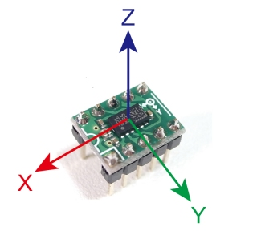
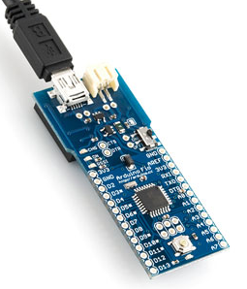
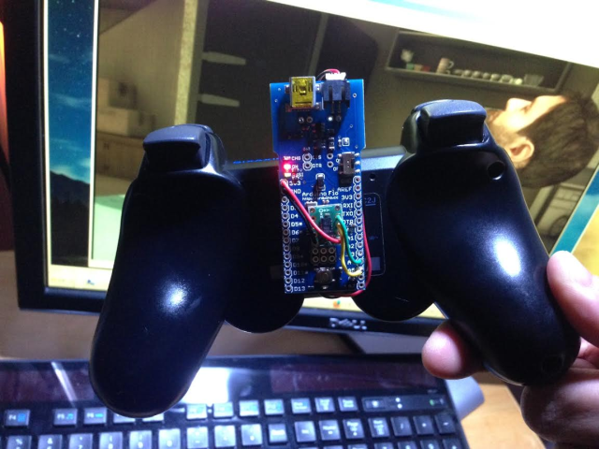
Quantification of body movement
+
3D accelerometer and magnetometer
LSM303DLHC (ST Microsystems)
ArduinoFIO (Sparkfun Electronics)+
XBEE Series1(Digi international)
Notes:
To quantify the(ジ) amount of body movement, we developed a wireless accelerometer using an accelerometer module and an Arduino-type microcomputer. The(ジ) accelerometer was mounted on the backside of the game pad. The(ジ) acceleration of each axis was integrated by a microcomputer, and the time-integrated value of acceleration was transferred to the PC wirelessly. The transfer rate was once per second. Because we didn’t measure the myoelectric potential, we considered it as a rough indicator of body movement.

Slide 8
Validation of wireless accelerometer
(AU)
Evaluated the relationship between the frequency of button pushing and the measured value of acceleration.
Integrated acceleration
Low condition：1 time/s
Middle condition：2 times/s
High condition：4 times/s
N=7
60
120
(s)
Figure 1-1. Integrated acceleration during button pushing.
(AU)
N=7
Averaged acceleration
The relationship between acceleration and the button pushing frequency was in the acceptable range.
Figure 1-2. Averaged acceleration of each condition.
Notes:
We executed a preliminary experiment for validating our wireless accelerometer. Seven students participated in three experimental conditions depending on the frequency of button pressing: Low condition, once per second; middle condition, 2 times per second; high condition, 4 times per second. Each condition consisted of rest and task periods that were each one minute in length. Participants pressed an arbitrary button of the game pad while watching the blinking LED for frequency control. The relationship between acceleration and the button pressing frequency was in the acceptable range, thus confirming that it could be used as a rough body movement indicator.

Slide 9
Experiment2

Slide 10
Purpose
To investigate the effect of the active coping aspect of a video game task on autonomic activities separate from the effect of body movement.
Method
Participants：36 students (18 men and 18 women)
(mean age= 21.0 years SD=2.38).
Experimental Design：Between subject design.
Experimental groups and time schedule：
Video game(VG)
Rest
6min
Task
arbitrary length
Recovery
4min
Movie(MV)
Rest
6min
Task
arbitrary length
Recovery
4min
Button-pressing(BP)
Rest
6min
Task
arbitrary length
Recovery
4min
Figure 2-1. Experimental schedule.
:Affect Scale
Notes:
In experiment two, we investigated the(ジ) effect of the(ジ) active coping aspect of a video game task on autonomic activities separate from the(ジ) effect of body movement. Thirty-six undergraduates were assigned to three experimental groups: playing a video game (VG), watching a game play movie (MV), and just button pressing (BP). The(ジ) experiment consisted of 6 minutes of rest, an arbitrary length of task, and 4 minutes of recovery. The task length of each group was adjusted to be the same. In addition to the physiological indices, we measured the subjective affect of each period. The score of the rest period was measured prior to the(ジ) experiment, and the score of the task and recovery period was measured after the(ジ) experiment by recollection.

Slide 11
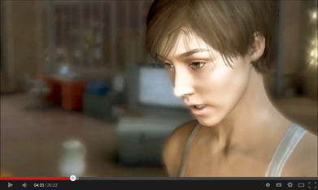

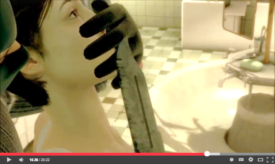
Task： Heavy Rain for Playstation3 （SONY Computer Entertainment）.
☓
□
Notes:
In this experiment, we used Heavy Rain as an experimental task. Heavy Rain is a mystery adventure game for Playstation 3 and is characterized by photorealistic 3D graphics and an intuitive game operation. From the(ジ) entire game story, we chose the stage "nightmare." In this stage, the player is attacked by armed thugs and has to press a specific button with good timing to survive.

Slide 12
Group configuration:
Audiovisual stimuli were identical
Movie (MV) group
(watch a recorded movie of the VG group)
Video game (VG) group
(play game normally)
Button-pressing (BP) group
(press buttons comparable to the VG group)
Generated acceleration was the same
Notes:
Our aim was to reveal the(ジ) extent to which active coping, in other words, judgment of the situation and decision-making processes, strengthen the(ジ) emotional arousal. During the gameplay of the VG group, play-screen and game-pad accelerations were recorded continuously.
In the movie (MV) group, participants watched a recorded movie at the same audiovisual setting as the VG group.
The button-pressing (BP) group was instructed to press buttons to trace the recorded acceleration trend of the VG group, using the software that was created specifically for this purpose.
状況判断・行動決定過程が、どの程度感情喚起を強めるかを検討するため、通常どおりゲームを行うゲーム群と、プレイ動画を見るだけの動画群を設ける。しかし、両群の生体反応の差は、ボタン押しに伴う運動の影響をも含んでいる。そこで、ゲーム群と同程度の運動を行うが、映像や音声は視聴しないボタン押し群を設ける。

Slide 13
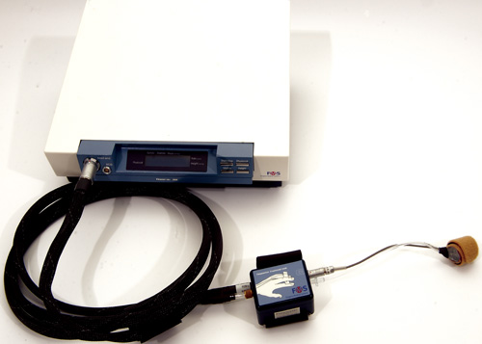
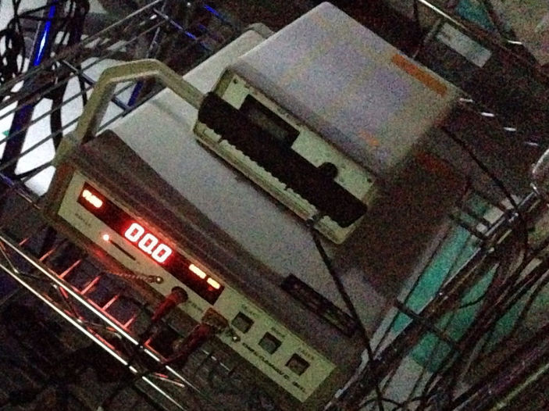
Physiological measures：
・Systolic blood pressure (SBP)
・Diastolic blood pressure (DBP)
・Heart rate (HR)
・Cardiac output (CO)
・Total peripheral resistance (TPR)
Recorded with a Finometer MIDI
(Finapres Medical Systems).
・Finger blood flow (FBF)
Recorded from the fourth finger of the non-dominant hand with a laser doppler flowmetry FLO-C1 (Omegawave, Japan).
・Skin conductance (SC)
Recorded from the fourth and fifth finger of the non-dominant hand with a skin conductance amplifier DA-3 (Vega Systems, Japan).
Notes:
In this experiment we measured hemodynamic response using the finometer MIDI. We also measured finger blood flow and skin conductance as shown on the slide.

Slide 14
Psychological measures：
General Affect Scale, consisted of 24 adjective-items that were arranged in three dimensions, Positive affect (PA), Negative affect (NA), and Calm affect (CA) (Ogawa, Monchi, Kikuya & Suzuki,2000).
Notes:
We used the general affect scale to measure the subjective affect. This consisted of 24 adjective items that reflected three aspects: positive affect (PA), negative affect (NA), and calm affect (CA).

Slide 15
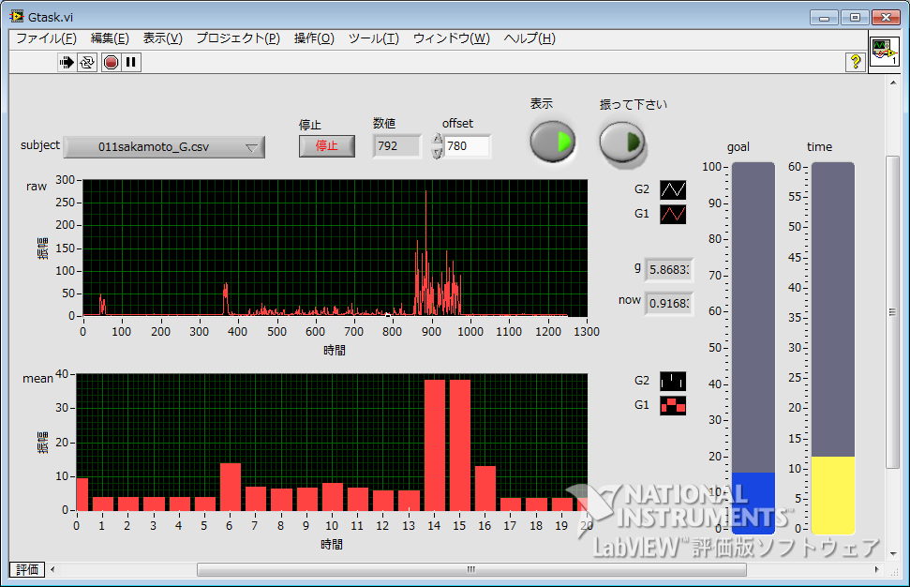
Result (Acceleration generated by BP group)
・Instructed to press buttons to trace the recorded acceleration trend of the VG group.
The target value of the acceleration is presented in 1-min intervals.
(AU)
n.s.
・No significant differences were found between the VG and BP groups.
Averaged acceleration
・We concluded that the degree of body movement of the two groups was the same.
VG Group
BP Group
Figure 2-2. Averaged acceleration of VG and BP group.
Notes:
Participants of the BP group were instructed to press buttons to trace the(ジ) acceleration of the VG group. The target value of the(ジ) acceleration was presented in 1-min intervals by the software, and participants were informed of the(ジ) only mark of the desired button on the screen. The target button was changed randomly every minute.
The results showed no statistical difference in the acceleration value between the VG and BP groups. We therefore determined that there is no difference between the two groups in terms of body movement.

Slide 16
Results(SBP・DBP)
(mmHg)
SBP
n=12
n=12
n=11
(mmHg)
DBP
VG
VG
MV
MV
BP
Diastolic blood pressure
BP
Systolic blood pressure
Figure 2-3. Mean SBP fluctuation for each group.
Figure 2-4. Mean DBP fluctuation for each group.
・Significant interaction between group and period was found
(SBP F(6,90) = 10.34, p<.001; DBP F(6,90)=9.21, p<.001).
・Significant simple effect of period was found in the VG and MV groups, but there was only a modest amount of change in the MV group.
・The BP group showed no significant simple effect in SBP and DBP.
Notes:
Roughly speaking, the(ジ) increase in the VG group was prominent, while the reaction of the other groups was modest. In particular, the(ジ) amount of reaction from the BP group was far below our expectations. Even by watching equivalent audiovisual stimuli, and even by performing equivalent physical activity, there was no SBP or DBP change at game time.

Slide 17
Cardiac Output
Total Peripheral Resistance
Mean Blood Pressure
MBP
=
CO
×
TPR
SV × HR
Stroke Volume
Heart Rate
The hemodynamic responses measured during various stress tasks were divided into two major patterns(Williams,1986; Sawada,1998).
Cardiac dominant pattern
Vascular dominant pattern
Change core
Change core
MBP
（mmHg）
CO
（%）
TPR
（%）
MBP
（mmHg）
CO
（%）
TPR
（%）
Computerized high-attentive tasks are likely to show a vascular dominant pattern(Berntson, Cacioppo & Fieldstone, 1996; Inamori & Nishimura, 1995; Nagano, 2003).
Notes:
Before going on to the next slide, I would like to share a bit of information with you about this formula. MBP means mean blood pressure; CO means cardiac output; and TPR means total peripheral resistance. Cardiac output is the volume of blood being pumped by the heart in one minute; it is calculated by multiplying the stroke volume to the heart rate. This formula is the same as Ohm's law; thus, both the TPR and CO contribute to increases in blood pressure.
A number of studies have found that there are two major hemodynamic patterns, namely, the cardiac dominant and vascular dominant patterns. Even if the MBP increases at the same level, the major factor of blood pressure elevation is different in these two types of hemodynamic regulation. Among many types of experimental tasks, a high-attentive visual task – like a video game – is known for its likelihood of resulting in a vascular dominant response.

Slide 18
Results (CO・TPR)
(L/m)
(MU)
CO
n=12
n=12
n=11
TPR
VG
MV
BP
Cardiac Output
Total Peripheral Resistance
VG
MV
BP
Figure 2-5. Mean CO fluctuation for each group.
Figure 2-6. Mean TPR fluctuation for each group.
・Significant interaction between group and period was found for CO
(CO F(6,90)=8.26, p<.001; TPR F(6,90)=1.02, n.s.).
・Significant simple effect of period was found only in the VG group
(CO F(3,90)=29.35, p<.001).
・No significant simple effect of period was found in the MV and BP groups.
Notes:
As for the CO and TPR variations, it seemed that the hemodynamic response pattern of the MV group and the VG group were qualitatively different. Concretely speaking, the definite cardiac dominant response of the VG group was what reminded us of the hemodynamic regulation during exercise.

Slide 19
Results (HR・FBF・SC)
(ml/100g/min)
FBF
(bpm)
HR
n=12
n=12
n=11
VG
Finger Blood Flow
MV
BP
VG
Herart Rate
MV
BP
Figure 2-8. Mean FBF fluctuation for each group.
Figure 2-7. Mean HR fluctuation for each group.
(μS)
SC
VG
・Significant interaction between group and period was found.
(HR: F(6,90)=5.79, p<.001 FBF: F(6,90)=4.29, p<.001
SC: F(6,90)=6.15, p<.001)
MV
BP
Skin Conductance
Figure 2-9. Mean SC fluctuation for each group.
・Significant simple effect of period was found in the VG group for all indices.
(HR: F(3,90)=19.12, p<.001; FBF: F(3,90)=19.29, p<.001; SC: F(3,90)=27.15, p<.001).
Notes:
As for HR, FBF, and SC, like the other indices, only the VG group indicated the prominent change during the task period. Although it was not statistically significant, the HR of the first half of the task seemed to have decreased.

Slide 20
Results (Subjective affect)
PA
NA
CA
VG
VG
VG
MV
MV
MV
BP
BP
BP
Figure 2-10. Mean score of general affect scale for each condition.
・Significant effect of period was found for all dimensions
(PA: F(2,64) = 15.5, p<.001; PA: F(2,64) = 46.2, p<.001; CA: F(2,64) = 57.3, p<.001).
・Significant interaction between group and period was found in NA and CA
(NA: F(6,90) = 8.26 ,p<.001; CA: F(6,90)=1.02, n.s.).
・Significant simple effects of period were found for all groups in NA and CA.
Notes:
With regard to variations of the subjective affects, positive and calm affect decreased and negative affect increased during the task period, respectively. Also in the subjective affect, the change amount was smallest in the BP group. However, unlike physiological measures, differences between the VG and MV groups were relatively small.

Slide 21
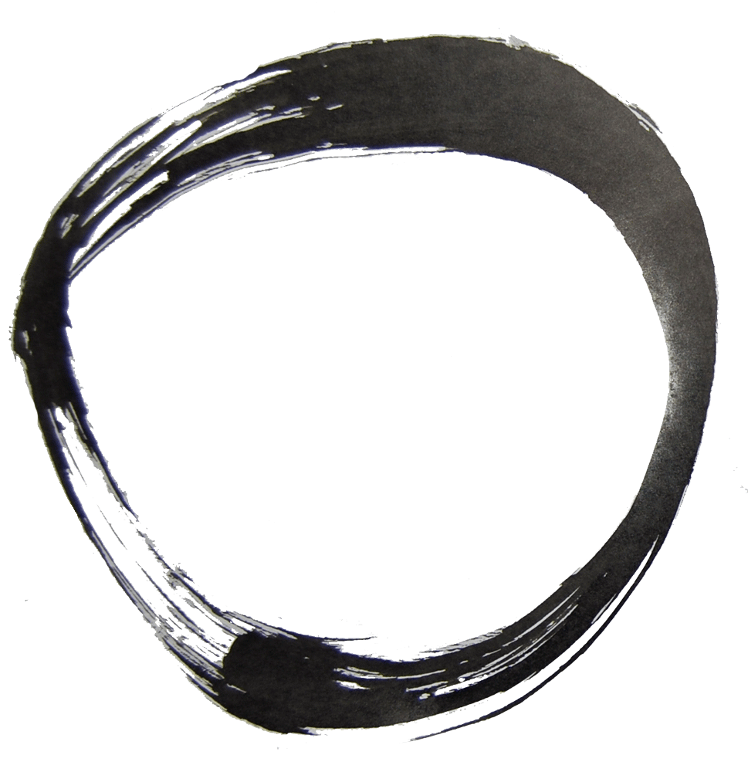
Discussion
・In general, physiological changes of the MV group were fairly modest compared with those of the VG group.
・The BP group showed no significant physiological change despite their considerable body movement.
-> Physiological changes mainly induced by its active coping process?
Body
movement
Active
Coping
Active Coping
Body
movement
Notes:
The aim of this experiment was to reveal the(ジ) extent to which active coping influences emotional arousal. In general, the physiological changes of the MV group were fairly modest compared with those of the VG group. The BP group showed no significant physiological change despite their considerable body movement. From these results, we have interpreted that physiological responses observed during video game playing have been mainly induced by the(ジ) active coping process.

Slide 22


Discussion
・The CO increases and the TPR decrease in the VG group were similar to the reaction during physical activity.
(Paulev, Jordal, Kristensen, Ladefoged, 1984; Rueckert, Slane, Lillis, & Hanson, 1996)
-> Possibility of the occurrence of a highly immersive state of fight or flight.
・Contrary to the VG group, the MV group indicated a slight TPR increase and HR deceleration.
-> Hemodynamic regulation observed in the MV group was a responses commonly found in visual presentation tasks.
(Kasprowicz, Manuck, Malkoff & Krantz,1990; Sawada, Nagano, & Tanaka, 2002; Waldstein, Bachen & Manuck,1997)
Notes:
In addition, focusing on the hemodynamic pattern, that of the VG group was similar to the reaction during physical activity. As it is widely known, tasks which induce intensive attention often provoke vascular dominant blood pressure elevation accompanied by cardiac vagal activation. Responses observed in the VG group were fundamentally different from such ones. So, we considered that there is a possibility of the occurrence of a highly immersive state of the fight or flight response, similar to real life.
Contrary to the VG group, the MV group indicated a slight TPR increase and HR deceleration. This was actually a common hemodynamic pattern often seen during the movie viewing or picture presentation tasks. It's a reaction when participants accept the situation as somebody else's problem.

Slide 23
Discussion
・Unlike the physiological indices, the differences in subjective affect between the VG and MV groups were ambiguous.
-> The results of the questionnaire seemed to be susceptible to audiovisual stimuli?
-> The possibility that biological information can be advantageous to investigate emotional change in more realistic situations.

Slide 24
Conclusion
・In the autonomic responses obtained during video game playing, the component derived from body movement is relatively small.
・ Only a combination of active coping and audiovisual stimulus can elicit physiological response, such as occurs in real situations.
・Video games can be understood as a form of entertainment that involves greater emotional reaction utilizing active coping.
・Video games have a great potential to become an excellent choice as an emotional arousing task in the laboratory setting.

Slide 25
Thank you all for listening!
Notes:
Thank you for your attention!

